Slide 1

Chapter 5
Series: Tuple and List

Slide 2
Content
Collection data types
Function len()
Index and slicing
Check for occurrence in a Tuple or List
Methods for mutations of List and keyword del
Loop through a Tuple or List
Operators +, *, <, >, ==, is
Nested Lists
Functions tuple() and list()

Slide 3
Collection data types
There are 4 collection data types in Python. We use them when we have a collection of objects that we want to address as a whole in a program
List is a collection which is ordered and changeable.
Tuple is a collection which is ordered and unchangeable.
Set: see chapter 10
Dictionary: see chapter 10
Tuple and List are often called sequences
Examples
a film collection
a stack of books
the days of the week
temperature measurements of the past week
…

Slide 4


Collections
in place of

Slide 5
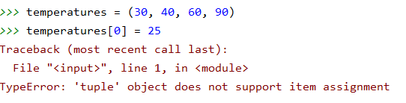
Tuple
Once created, the content of the tuple is fixed; a tuple is 'immutable'.
You cannot change or remove elements from the tuple
You can't add elements.
To create a tuple you use ( )
A tuple is immutable
0 | 1 | 2 | 3
30 | 40 | 60 | 90
temperatures = (30, 40, 60, 90)

Slide 6
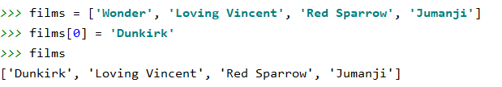
List
The content of a list can be changed at any time; a list is 'mutable'.
You can change elements in the list
You can remove elements from the list
You can add new elements to the list
To create a list you use [ ]

Slide 7
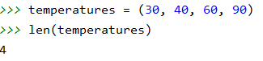
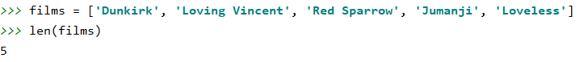
Function len() (List and Tuple)
Using the function len() you can retrieve the number of elements in a series
0 | 1 | 2 | 3
30 | 40 | 60 | 90

Slide 8
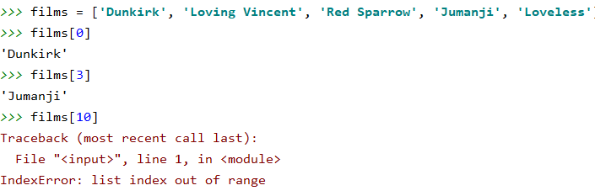
Index (List and Tuple)
Each object in the series can be addressed on the basis of its serial number or so-called index in the series.
The first item in the series has index 0
0 | 1 | 2 | 3 | 4
Dunkirk | Loving Vincent | Red Sparrow | Jumanji | Loveless

Slide 9
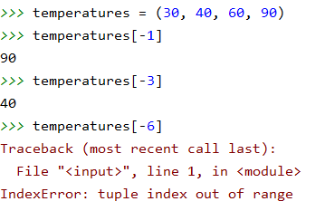
Index (List and Tuple)
You can also count the index position starting from the last element in the series.
The last element has index -1.
0 | 1 | 2 | 3
30 | 40 | 60 | 90
-4 | -3 | -2 | -1

Slide 10
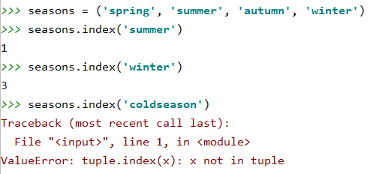
Method index (List and Tuple)
You can also search the index position of an element.
You will receive an error message when the element is not found.
When an element occurs more than once in the series, the index of the first occurrence is returned.
0 | 1 | 2 | 3
spring | summer | autumn | winter

Slide 11
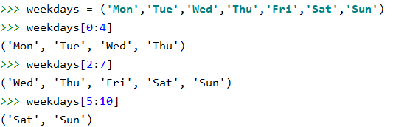
Slicing (List and Tuple)
Slicing means that via the index positions [lower limit : upper limit] you indicate which part you want to take out of the series. Lower limit is included in the selection, upper limit is not included.
The result of slicing is another series.
0 | 1 | 2 | 3 | 4 | 5 | 6
Mon | Tue | Wed | Thu | Fri | Sat | Sun
-7 | -6 | -5 | -4 | -3 | -2 | -1

Slide 12
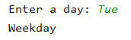
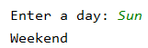
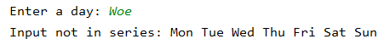
Check for occurrence in List or Tuple
Check whether a day falls during the week or during the weekend
weekdays = ('Mon', 'Tue', 'Wed', 'Thu', 'Fri', 'Sat', 'Sun') day = input('Enter a day: ') if day in weekdays[0:5]: print('Weekday') elif day in weekdays[5:]: print('Weekend') else: print('Input not in series:', *weekdays)
element in series is a boolean expression which returns True when the element is in the range
print(*tuple) prints content without () same for print(*list)

Slide 13
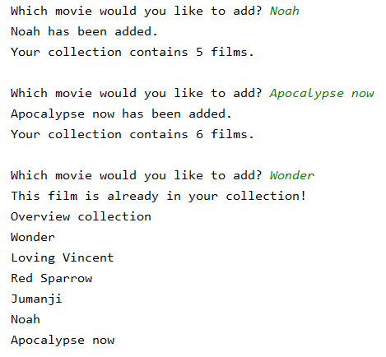
Check for occurrence in List or Tuple
Script to add new movies to your collection.
films = ['Wonder', 'Loving Vincent', 'Red Sparrow', 'Jumanji’]
Your film collection only contains unique titles. When you enter an existing film, you can no longer expand the collection.
Iteration!

Slide 14
Check for occurrence in List or Tuple
films = ['Wonder', 'Loving Vincent', 'Red Sparrow', 'Jumanji'] new_film = input("Which movie would you like to add? ") while not new_film in films: films.append(new_film) print(new_film, "has been added. \nYour collection contains", len(films), "films.") new_film = input("\nWhich movie would you like to add? ") # when an existing movie is entered, we show the overview print("This film is already in your collection!") print("Overview collection") for film in films: print(film)

Slide 15
Methods for mutations of List
films = ['Wonder', 'Loving Vincent', 'Red Sparrow', 'Jumanji']
method | functionality | example and result
append | add an element at the end of the list | films.append('Loveless') ['Wonder', 'Loving Vincent', 'Red Sparrow', 'Jumanji', 'Loveless']
insert | add an element at indicated position in the list (add in front = position 0) | films.insert(2, 'Loveless') ['Wonder', 'Loving Vincent', 'Loveless', 'Red Sparrow', 'Jumanji']
remove | delete the first element of the list with the specified value | films.remove('Wonder') ['Loving Vincent', 'Red Sparrow', 'Jumanji']
pop | delete element at indicated position* | films.pop(0) ['Loving Vincent', 'Red Sparrow', 'Jumanji']
(*) when no index position is included, the last element in the list is deleted
Notes:
In the next 2 slides we discuss a few methods for manipulating a list. Notice that these methods cannot be used with tuples while tuples are immutable by default.
When you want to add an element to a list, you can choose between the append or insert method. By using the append, the new item is always added to the end of the list.
When you want the new elment to appear at a specific index position, you must use the insert method. For deleting elements, you can choose between remover or pop. The remove method asks for the value you want to delete, while the pop method needs the index position that must be deleted.

Slide 16
Methods for mutations of List
method | functionality | example and result
sort | order the elements of the list | films.sort() ['Jumanji', 'Loving Vincent', 'Red Sparrow', ‘Wonder']
reverse | reverse order of elements | films.reverse() ['Jumanji', 'Red Sparrow', 'Loving Vincent', 'Wonder']
extend | add a second list at the end of the first | films.extend(['Loveless', 'it']) ['Wonder', 'Loving Vincent', 'Red Sparrow', 'Jumanji', 'Loveless','it']
index | look up position where element appears for the first time | films.index('Wonder') 0 films.index('Ten') ValueError Error message if no occurrences are found (*)
count | counts number of elements | films.count('Wonder') 1
(*) To check whether an element appears in the list, it is better to use: if 'Ten' in movies:
Notes:
When a list needs to be sorted, this can be done quickly with the builtin sort method.
After sorting a list alphabetically, you can eaisly sort it from Z to A descending by calling the reverse methode.
Futhermore, you can combine 2 lists by using the extend method. As you see in the example the movies LoveLess and IT are added 2 the orginal films list. Finally, you can look up whether or not an item exists. This can be done with the index method. This method return the index position of the element you are looking for. However when the elemenent is’nt part of the list an error is returned. While responding to an error in code is not that easy, a far more handy way of checking whether a value belongs to a liss is using a simple if. If value in list then … Finally, you can use the count ùehtod if you want to retrieve how many times an items occurs in a list.
Also adding a new list to an existing one, can be easily arranged with the extend method.
When you want to combine 2 lists that can be done with the extend method.

Slide 17
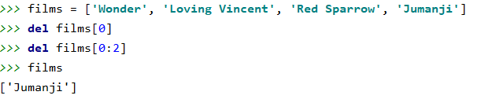
List mutation via keyword del
del is neither a function nor a method of a list but a reserved Python keyword
Via del you can remove an element or a series of elements from a list based on the index.
Exact position
From start position to end position (not included)

Slide 18
Loop through a List or Tuple
To address all elements of a series one by one, for example to print them, you use an iteration.
2 possibilities: FOR and WHILE
FOR
for loop
for loop with range
WHILE
while structure using the index position

Slide 19
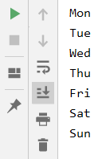
Loop through a Tuple
Example of a for loop
weekdays = ('Mon', 'Tue', 'Wed', 'Thu', 'Fri', 'Sat', 'Sun')
for day in weekdays: print(day)
Using the variable day, the tuple is run from index 0 up to and including index 6.

Slide 20
Loop through a Tuple
Example of a for loop with range
weekdays = ('Mon', 'Tue', 'Wed', 'Thu', 'Fri', 'Sat', 'Sun') for i in range(len(weekdays)): print(weekdays[i])
Variable i loops through the range from 0 to len (weekdays). len (weekdays) is 7, so index positions from 0 to 6 will be printed!

Slide 21
Loop through a Tuple
Example of a while loop (always uses the index)
weekdays = ('Mon', 'Tue', 'Wed', 'Thu', 'Fri', 'Sat', 'Sun') index = 0 while index < len(weekdays): print(weekdays[index]) index += 1
Variable index starts at 0. The number of elements in the series is len(weekdays) or 7.
The loop is executed as long as the variable index is less than 7. So index positions from 0 to 6 will be printed!

Slide 22
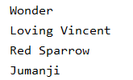
Loop through a List
A List can also be looped through with a for or a while loop.
Examples if you do NOT make any changes to the List
films = ['Wonder', 'Loving Vincent', 'Red Sparrow', 'Jumanji'] for film in films: print(film) for i in range(len(films)): print(films[i]) index = 0 while index < len(films): print(films[index]) index += 1

Slide 23
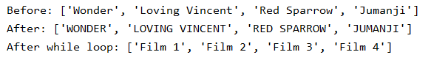
Loop through a List
If you want to iterate through the List to make changes you can NOT use a simple for loop
films = ['Wonder', 'Loving Vincent', 'Red Sparrow', 'Jumanji'] print('Before:', films) for i in range(len(films)): films[i] = films[i].upper() print('After:', films) index = 0 while index < len(films): films[index] = 'Film ' + str(index + 1) index += 1 print('After while loop:', films)

Slide 24

Initialise a List
New empty list:
new_list = []
You can fill this list:
via a loop (eventually using an input statement)
with append or insert
Make a list based on another existing list:
Remark: a Tuple is immutable so it makes no sense to start with an empty Tuple
films = ['Wonder', 'Loving Vincent', 'Red Sparrow', 'Jumanji'] films2 = ['IT', 'Once upon a time', *films[1:-1], 'Bad Cop']

Slide 25
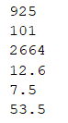
Functions max, min and sum (List and Tuple)
You can use the max() and min() functions to determine the maximum and minimum respectively of a sequence consisting of numbers.
You can summerize the elements of a sequence of numeric elements using the sum() function.
r1 = (327, 419, 101, 667, 925, 225) print(max(r1)) print(min(r1)) print(sum(r1)) r2 = [12.1, 7.5, 9.9, 11.4, 12.6] print(max(r2)) print(min(r2)) print(sum(r2))

Slide 26


Operators (List and Tuple)
+ and *
teaching_days = ('Mon', 'Tue', 'Wed', 'Thu', 'Fri') lesson_hours = (3, 4.5, 6, 4.5, 3) lesson_hours_per_day = teaching_days + lesson_hours print(lesson_hours_per_day)
greek_letters = ['alpha', 'beta', 'omega'] more_letters = greek_letters * 4 print(more_letters)
Note that a sequence may contain a mix of data types: string, integer, float, ...

Slide 27
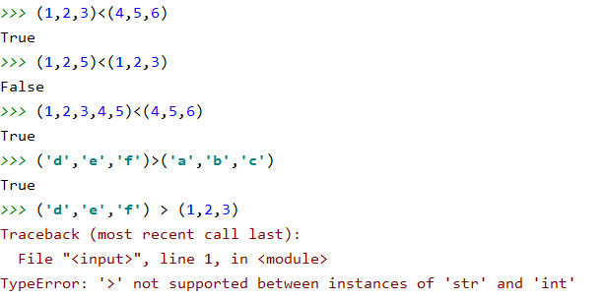
Operators (List and Tuple)
Comparison operators < and >
Only the corresponding positions are compared. The size of the series is not taken into account.

Slide 28
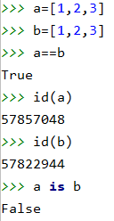
Series and operators (List and Tuple)
Comparison operator == checks if the content of the series is identical
is checks that both sets refer to the same memory location
With function id() you can retrieve this memory location
program
main memory
=
list
a
1,2,3
list
b
1,2,3

Slide 29
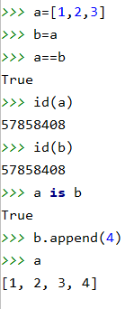
Series and operators (List and Tuple)
Comparison operator == checks if the content of the series is identical
is checks that both sets refer to the same memory location
program
main memory
=
list
1,2,3
a
1,2,3,4
b
A new memory location will only be provided if a series is assigned its own values when it is created. Here b is an alias for a.

Slide 30
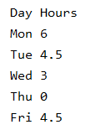
Nested sequences (List and Tuple)
1 List with hours of lessons per day
By using nested lists it’s more clear which data belongs together. The result is a nested list where each element in that list is a list itself.
list_hours_day = ['Mon', 6, 'Tue', 4.5, 'Wed', 3, 'Thu', 0, 'Fri', 4.5]
hours_school_day = [['Mon', 6], ['Tue', 4.5], ['Wed', 3], ['Thu', 0], ['Fri', 4.5]] print('Day', 'Hours', sep='\t') for day_hours in hours_school_day: for item in day_hours: print(item, end='\t') print()

Slide 31
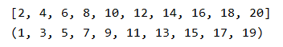
Tuple() and List() functions
Just as you can use the functions int(), str(), float(), ... to convert a variable to a desired data type, you can also convert a range to a desired type: Tuple or List.
Example: generate a list of the even numbers between 1 and 20 and a tuple with the odd numbers
even_numbers = list(range(2,21,2)) odd_numbers = tuple(range(1,21,2)) print(even_numbers) print(odd_numbers)

